Slide 1
HEALTHCARE COST Prediction
Data science project lifecycle
Tamilarasee Sethuraj

Slide 2
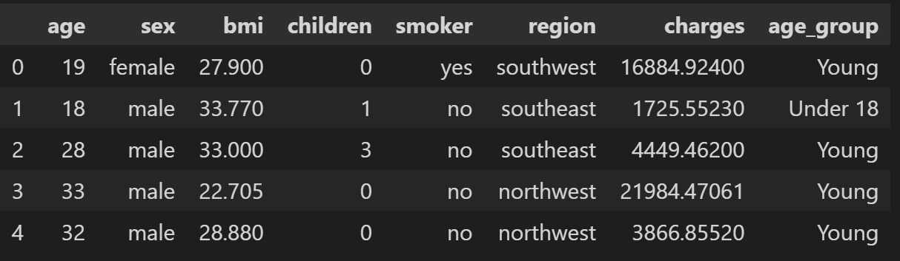
Data Understanding
Display and Analyze data - Average, Min/max values (Range), Categorize values by a col (age)

Slide 3
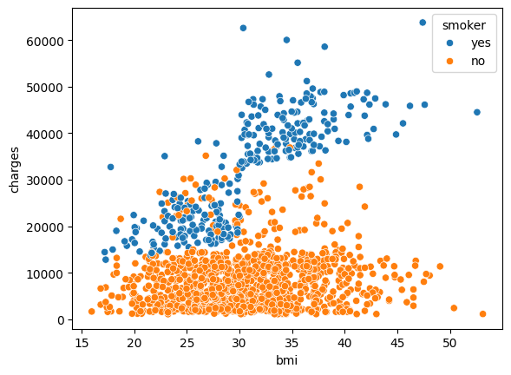
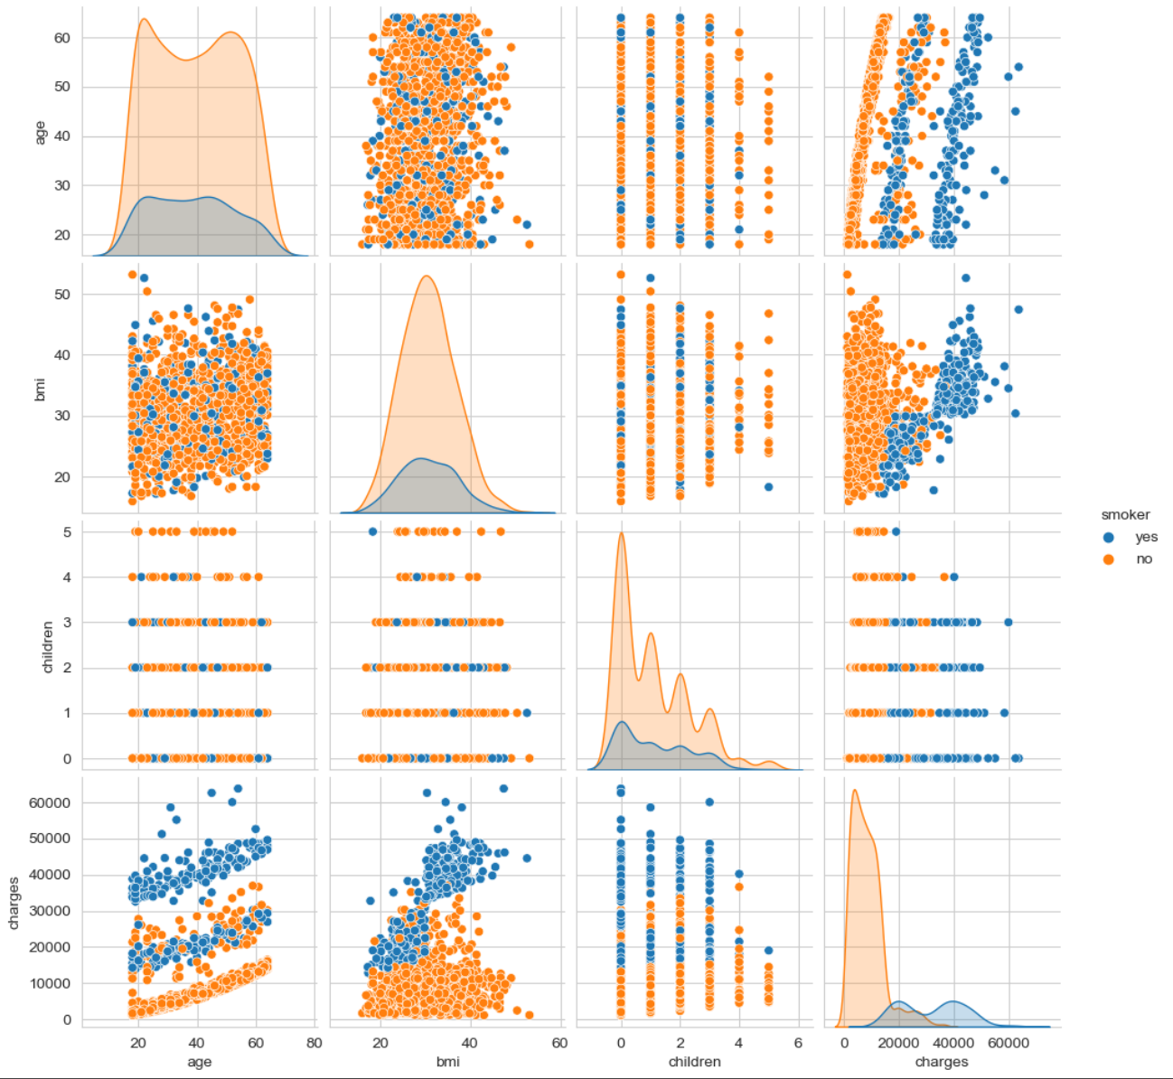
EDA
Visualize data based on category, Understand distribution/density of the features
Identify bias in the Dataset
Pair-plot to understand relationship among features(col)

Slide 4
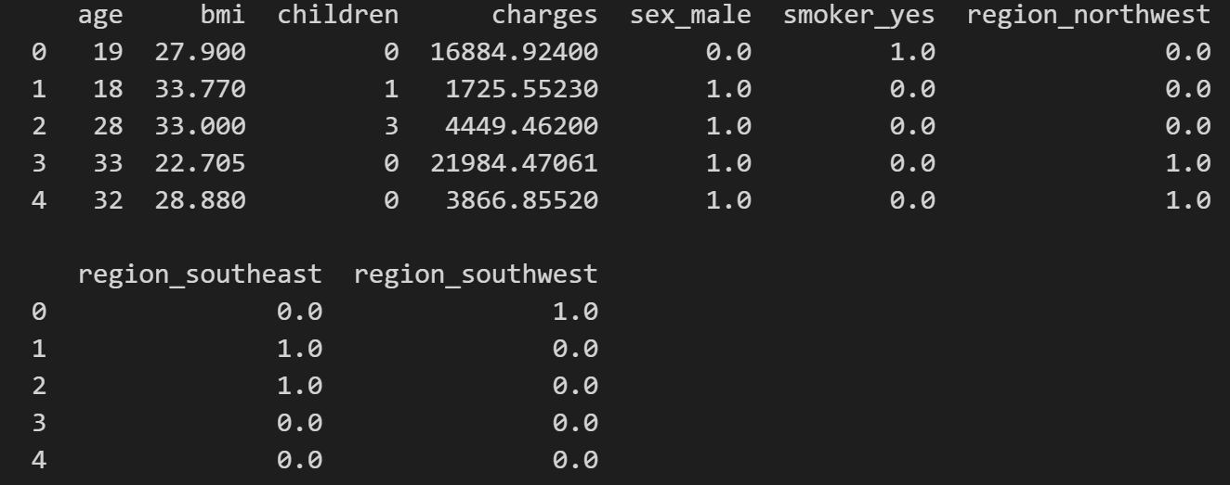
Feature Engineering
Preprocessing:
One-Hot Encoding (Categorical -> Numerical)
Standardize/Normalize Numerical data
Maintain same range for all features
Prevents bias in ML model processing

Slide 5
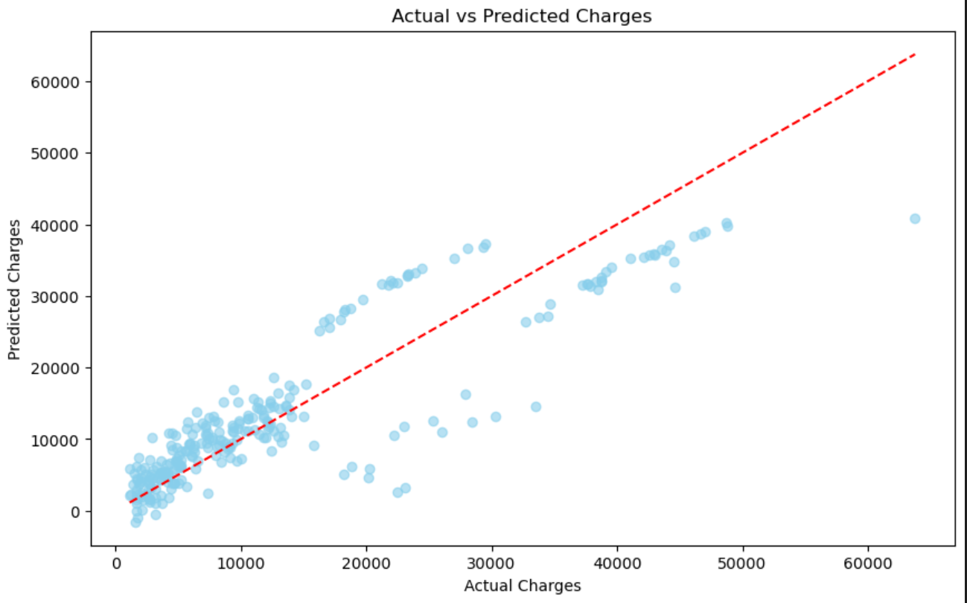
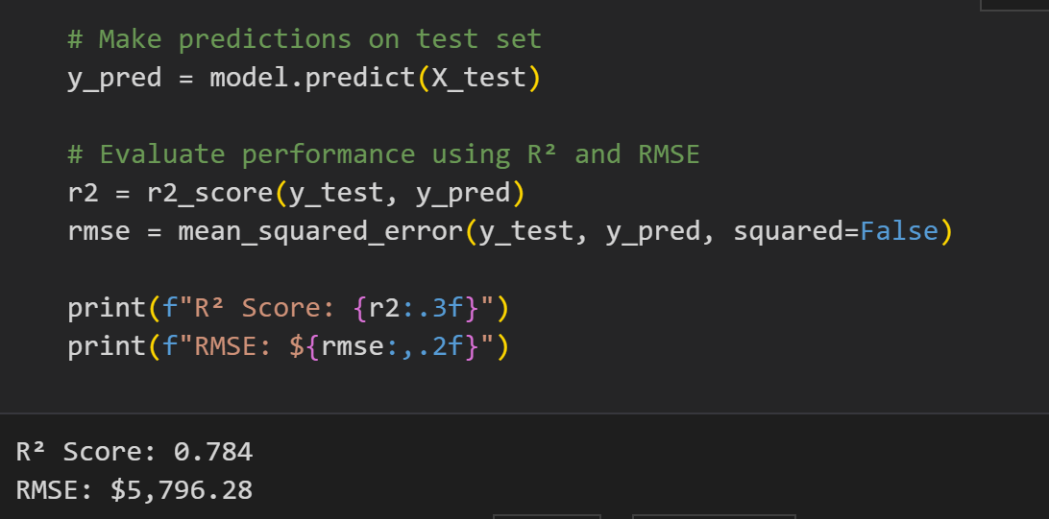
Machine Learning model
Model: Linear Regression (sklearn.linear_model.LinearRegression)
Split: 80% Train / 20% Test

Slide 6
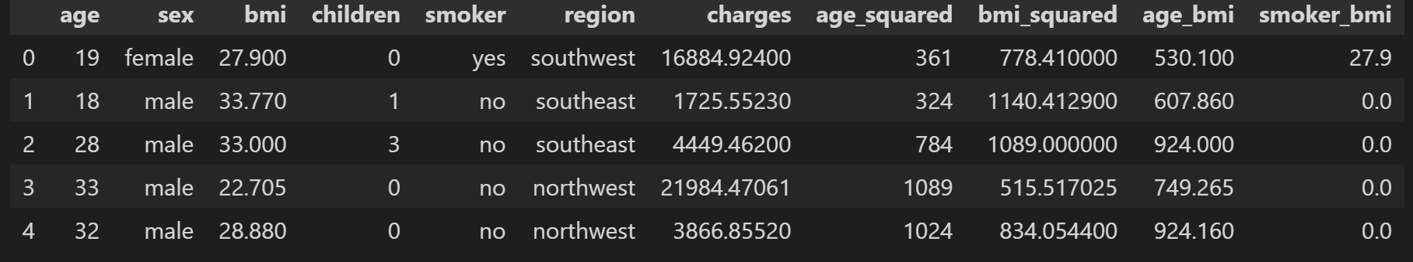
IMPROVED FEATURE ENGINEERING
Notes:
R2 shows how well your model explains the variance in the target variable
R2=1−SStot​SSres​​=1−∑(yi​−yˉ​)2∑(yi​−y^​i​)2​ Where:
SSresSS_{res}SSres​ = residual sum of squares (like MSE numerator)
SStotSS_{tot}SStot​ = total sum of squares (how much the values vary around the mean)
yˉ\bar{y}yˉ​ = mean of the actual values
MSE measures how close the predicted values are to the actual values. It does this by taking the average of the squared differences between predicted and actual values:
Why we use it:
Penalizes larger errors more due to squaring
Good for optimization (it’s differentiable, so it works well with gradient descent)
🚫 Drawbacks:
It's sensitive to outliers (because errors are squared)
The result is in squared units of the output (e.g., if predicting price in dollars, MSE is in dollars²)

Slide 7
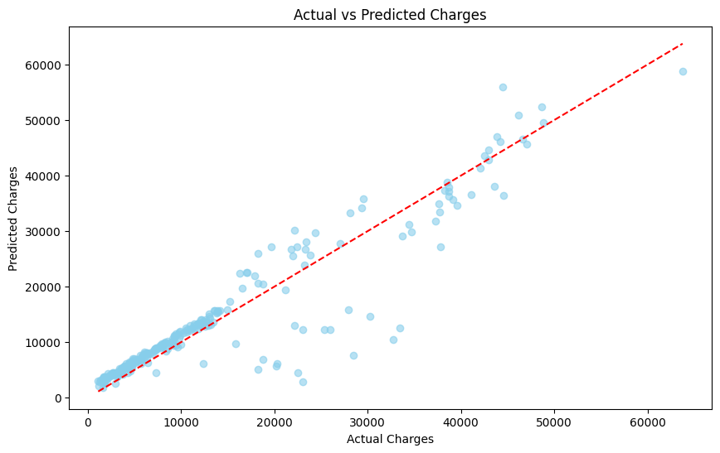
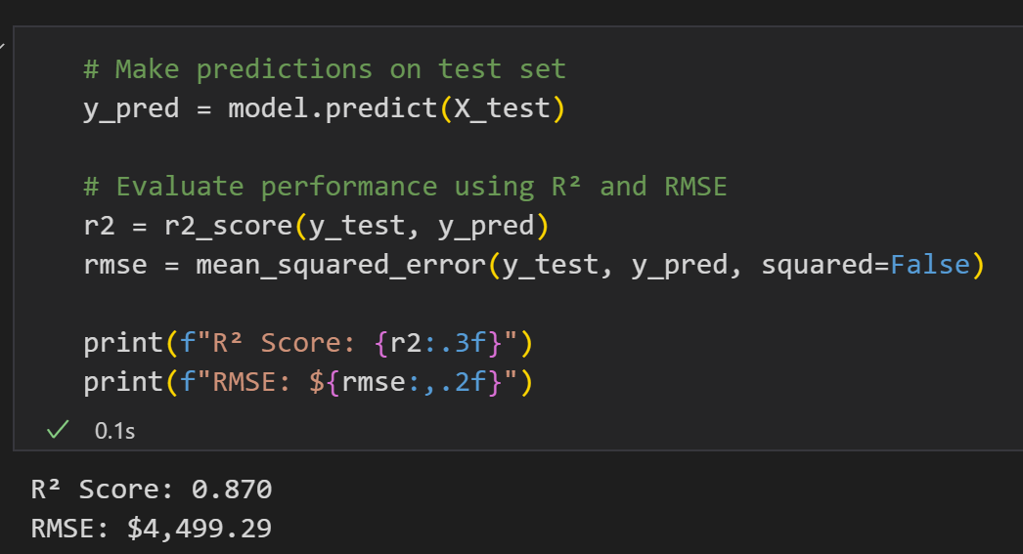
Prediction

Slide 8
BUILD WEB APP - DEPLOY
Export the model
Build app using Streamlit
Deploy in Streamlit Cloud - https://heathcare-cost-prediction.streamlit.app/

Slide 9
Thank you!

